Slide 1

Toolkit Doc19 Upper Arm MCB
May 11, 2011

Slide 2
General Safety Instructions
Always wear an ESD wrist strap when reaching into the robot.
Do not drop any screws into the robot. Any lost screws may cause the robot to malfunction. If you drop any screws into the robot, do not turn on the robot until you have contacted Willow Garage Support.
When removing screws, save screws by type. You will need screws that you have removed when replacing the components.
Use extreme caution when removing any cables. All cables are very difficult to repair or replace if broken.
Do not attempt to fix any electrical problems that are not specified in this document. Contact Willow Garage Support before attempting to service your PR2.
If you have any questions about using this document, contact Willow Garage Support before proceeding.
Pre-Start Checklist
Before starting to remove and replace a PR2 forearm camera make sure you have completed these steps:
Review instructions for “Robot Overview, Torque Tools, Loctite” and “Setting Torque Driver”.
Unplug robot from wall electrical power.
Power down robot and turn off DC breaker (red rocker switch on rear panel)
Required Tools and Materials:
PR2 Tool Kit and PR2 Accessory Kit

Slide 3
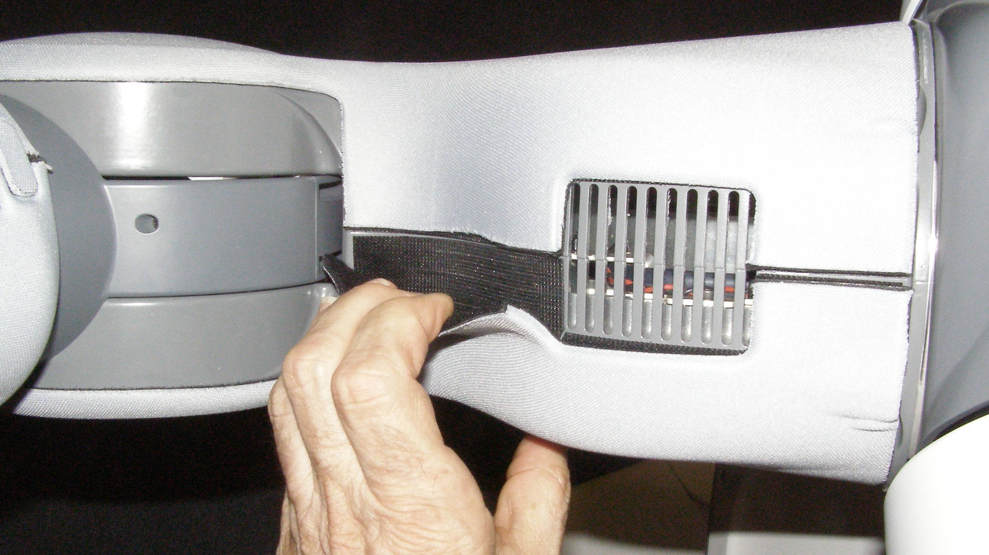
Upper Arm Cover Removal
Remove Upper Arm Outer Cover – 2545. It is strongly retained with Velcro. Peel the Cover off starting from the top edge.
Fig 1

Slide 4
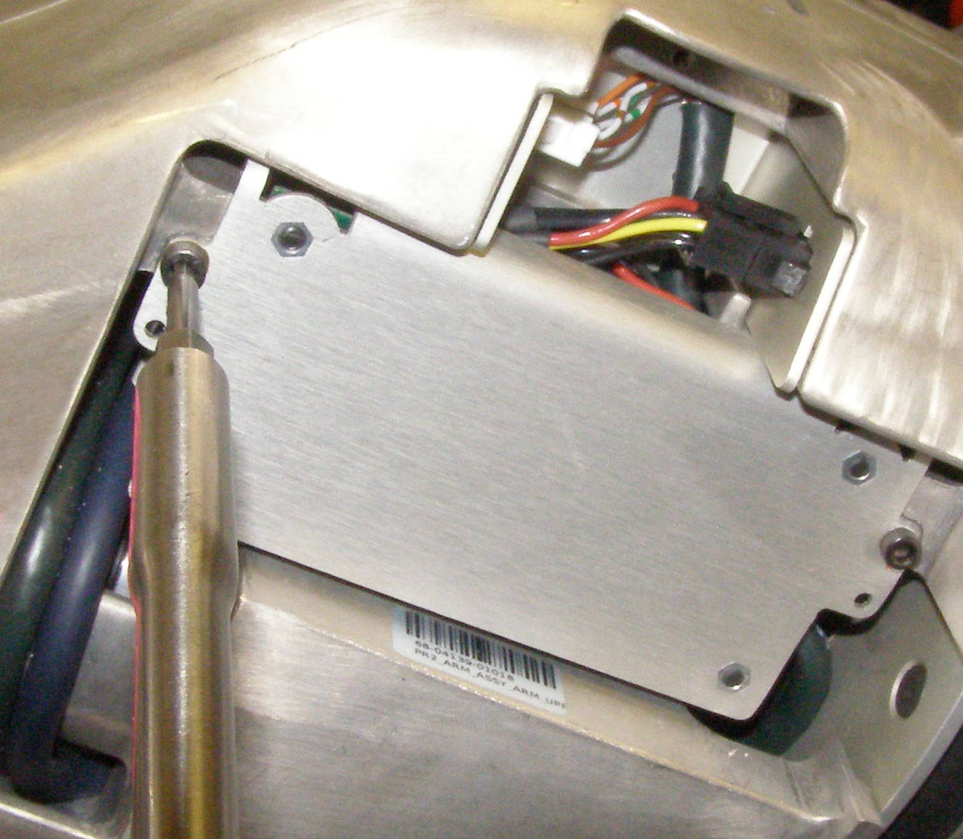
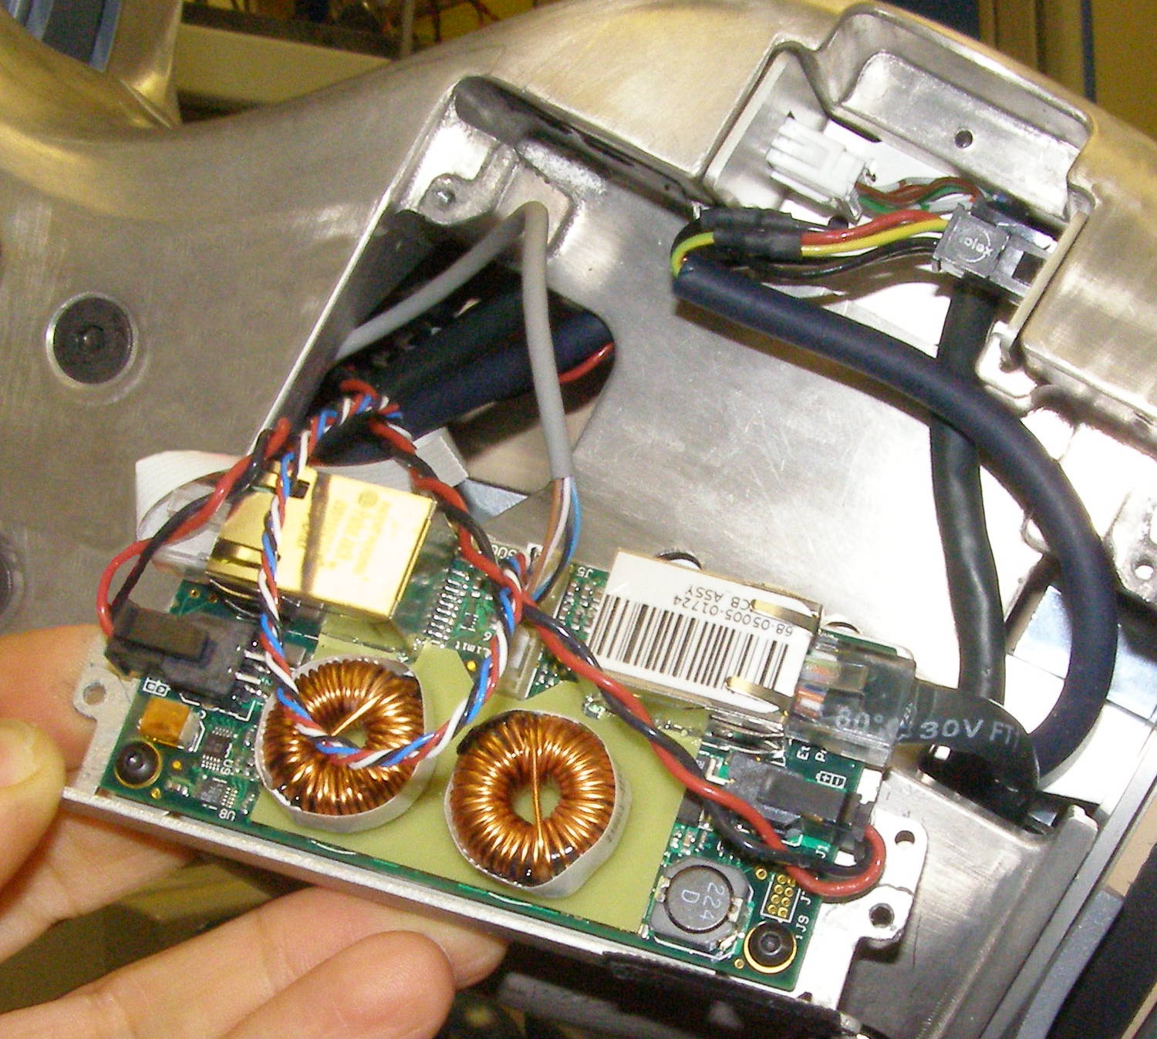
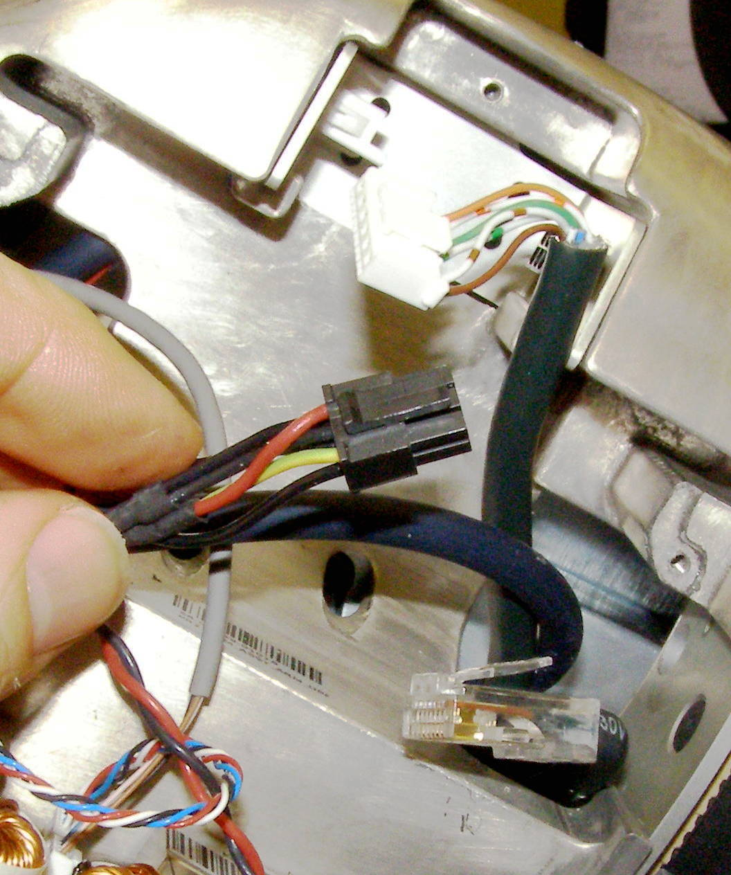
Upper Arm MCB Removal
  Using the 2.5mm bit with the T-handle driver, remove the 2 MCB Sled screws. 2009-06
  (Fig 2)
Fig 2
Fig 3
  Pivot the MCB Sled - 4286 out and disconnect the 3 cables as shown. (Fig 3,4)
Fig 4

Slide 5
Upper Arm MCB Install
Plug in the 3 cables. (Fig 5)
Fig 5
  Pivot the MCB Sled into place being careful not to damage or pinch any of the cables. Using Loctite 248, install the 2 screws and torque to 1.36Nm using the Large torque driver.

